Slide 1
GET SMART 2
2^D CLASS:
NEW WORDS AND VERBS
EXPRESSIONS AND FUNCTIONS
GRAMMAR IN ENGLISH
SCHOOL YEAR 2016-17
COTUGNO-CARDUCCI-GIOVANNI XXIII
SECONDARY SCHOOL

Slide 2
UNIT 1: THE SUN IS SHINING!

Slide 3
PRESENT SIMPLE
SOGGETTO+am/is/are
SOGGETTO+am/is/are+not
AFFERMATIVE FORM
I STUDY
YOU STUDY
HE STUDIES
SHE STUDIES
IT STUDIES
WE STUDY
YOU STUDY
THEY STUDY
EX:I ALWAYS STUDY ENGLISH
NEGATIVE FORM
I DON’T STUDY
YOU DON’T STUDY
HE DOESN’T STUDY
SHE DOESN’T STUDY
IT DOESN’T STUDY
WE DON’T STUDY
YOU DON’T STUDY
THEY DONT’T STUDY
EX:I DON’T RARELY STUDY ENGLISH

Slide 4
INTERROGATIVE FORM
QUESTIONS SHORT ANSWERS
DO I STUDY? YES,I DO/NO,I DON’T
DO YOU STUDY? YES, YOU DO/NO,YOU DON’T
DOES HE STUDY? YES,HE DOES/NO,HE DOESN’T
DOES SHE STUDY? YES,SHE DOES/NO,SHE DOESN’T
DOES IT STUDY? YES,IT DOES/NO,IT DOESN’T
DO WE STUDY? YES,WE DO/NO,WE DON’T
DO YOU STUDY? YES,YOU DO/NO,YOU DON’T
DO THEY STUDY? YES,THEY DO/NO,THEY DON’T
EX:DO YOU ALWAYS STUDY ENGLISH? YES,WE DO!
VERBS OF STATE
I LOVE ENGLISH. I LIKE SCHOOL. I UNDERSTAND ENGLISH.

Slide 5
PRESENT CONTINUOUS
SOGGETTO+am/is/are+ TEMPORARY ACTIONS
base form of the verb+ing This week,these days,
EX.WE ARE STUDYING ENGLISH this month,today,
now, at the moment

Slide 6
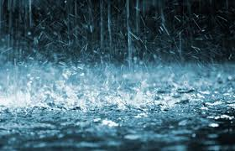
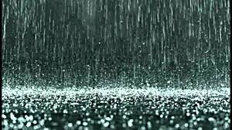
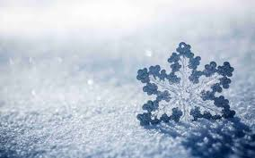
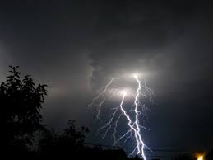
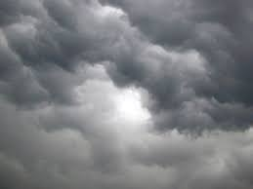
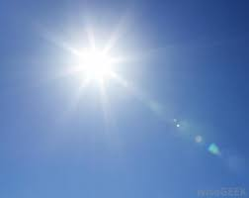
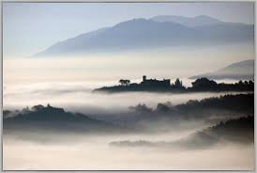
IT’S HAILSTONES AND FROST. IT’S 2 DEGREES.
IT’S RAINY AND WET.
IT’S 10 DEGREES
IT’S SNOWY AND FREEZING. IT’S -3 DEGREES.
IT’S THUNDER/ LIGHTNING AND HURRICANE. IT’S 5 DEGREES
WHAT’S THE WEATHER LIKE?
IT’S CLOUDY AND DRY. IT’S 12 DEGREES.
IT’S SUNNY.
IT’S 18 DEGREES.
IT’S FOGGY AND ICE .IT’S 9 DEGREES
IT’S HOT AND BOILING. IT’S 43 DEGREES.

Slide 7
UNIT 2: LUCA LIKES LISTENING TO ROCK!

Slide 8
GRAMMAR
Ex: I love eating ice cream
I like listening to rap
I don’t mind walking to school
I don’t like doing homework
I hate going to the dentist

Slide 9
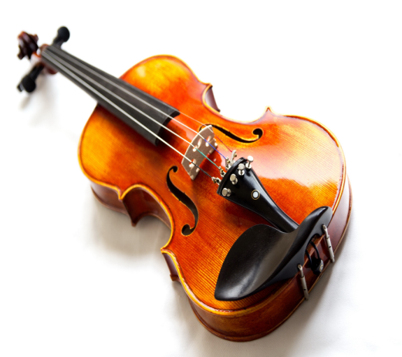
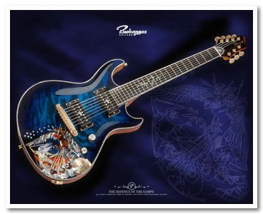
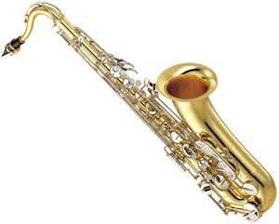
MUSIC
Classical-violin
Electric guitar-hearvy metal
Trumpet-jazz

Slide 10
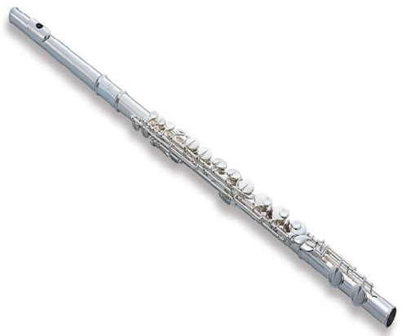
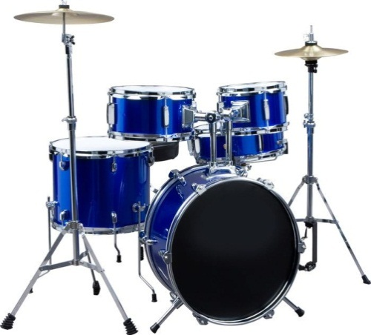
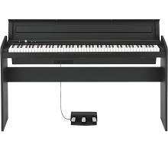
Drums-rap
Flute-opera
Keyboards-rock

Slide 12
UNIT 3: YOU WERE REALLY CUTE!

Slide 13
FACE
EYES
HEAD
NOSE
EAR
HAIR
MOUTH
TEETH
SHOULDER
NECK
CHIN
CHEST
ARM
ELBOW
HAND
LEG
FINGER
THUMB
KNEE
ANKLE
FOOT
TOE

Slide 14
GRAMMAR
FORMA AFFERMATIVA
FORMA NEGATIVA
I | WAS | HAPPY
YOU | WERE | HAPPY
HE | WAS | HAPPY
SHE | WAS | HAPPY
IT | WAS | HAPPY
WE | WERE | HAPPY
YOU | WERE | HAPPY
THEY | WERE | HAPPY
I | WAS NOT | HAPPY
YOU | WERE NOT | HAPPY
HE | WAS NOT | HAPPY
SHE | WAS NOT | HAPPY
IT | WAS NOT | HAPPY
WE | WERE NOT | HAPPY
YOU | WERE NOT | HAPPY
THEY | WERE NOT | HAPPY
1.SHE WAS IN LONDON LAST YEAR.
2.YOU WERE WITHOUT GLASSES THE LAST WEEK.
1.I WASN’T IN ITALY LAST MONDAY
2.WE WEREN’T AT HOME ONE WEEK AGO

Slide 15
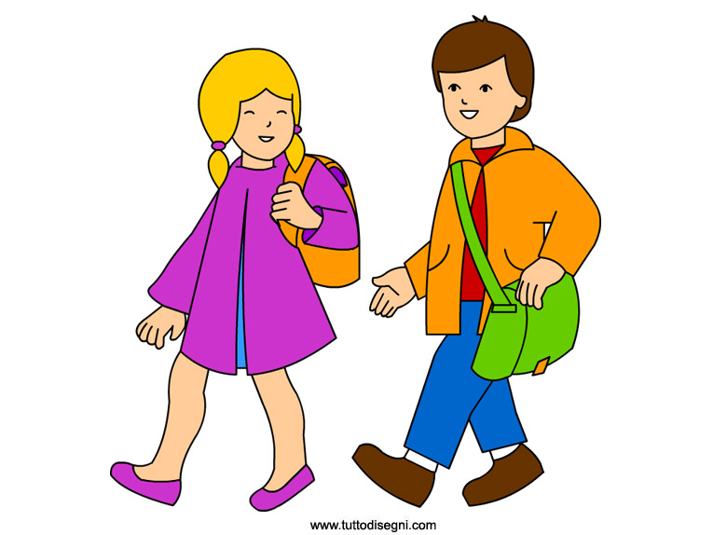
FORMA INTERROGATIVA
WHAT DOES LUCA TAKE AFTER IN HIS FAMILY AND WHAT DOES HE LOOK LIKE?
HE TAKE AFTER HIS FATHER. HE IS TALL AND SLIM. HE’S GOT SHORT BROWN AND CURLY HAIR. HIS EYES ARE GREEN. IT HAS AN OVAL FACE. HE HASN’T GOT MOUSTACHE. HE’S GOOD-LOOKING

Slide 16
UNIT 4: TOM WENT ON A PICNIC!

Slide 18
UNIT 5: DID LUCA ENJOY THE FILM?

Slide 19
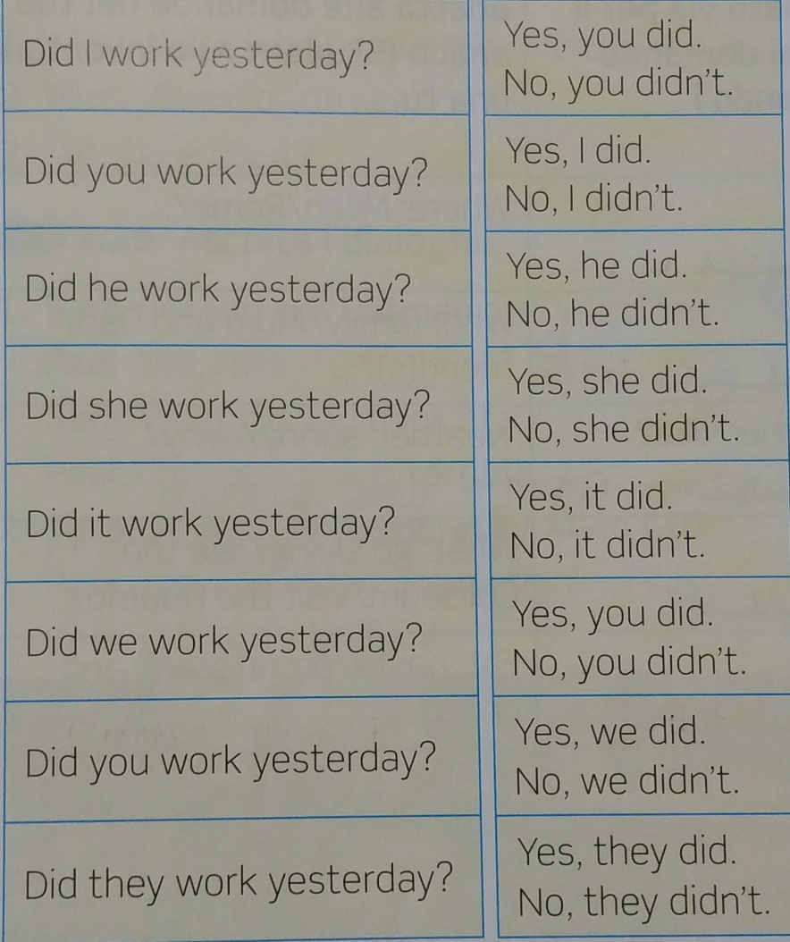
PAST SIMPLE DEI VERBI REGOLARI E IRREGOLARI
FORMA NEGATIVA
I DIDN’T WORK
YOU DIDN’T WORK
HE DIDN’T WORK
SHE DIDN’T WORK
IT DIDN’T WORK
WE DIDN’T WORK
YOU DIDN’T WORK
THEY DIDN’T WORK
FORMA INTERROGATIVA

Slide 20
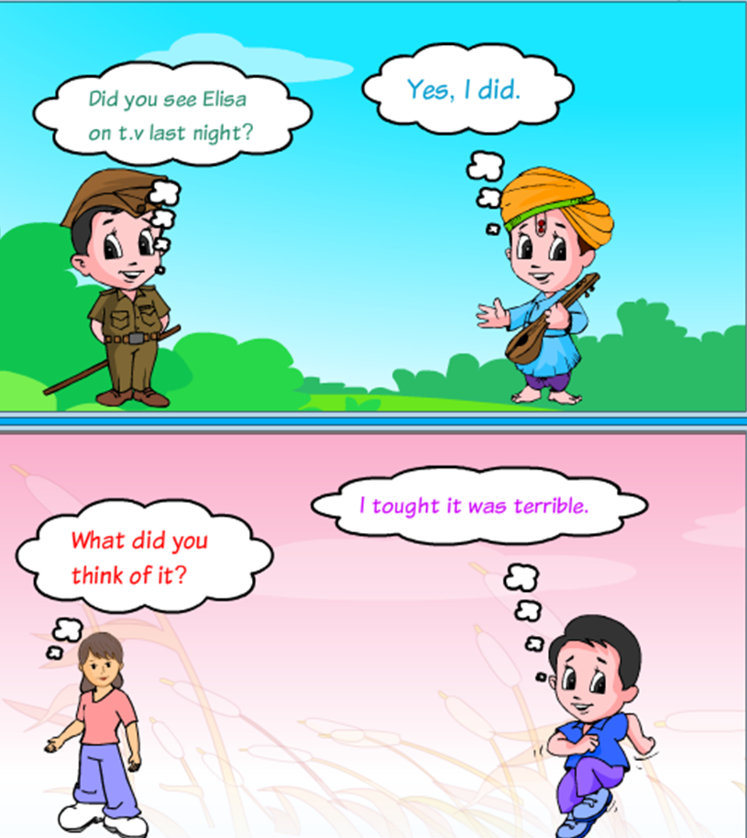

Slide 21
UNIT 6: WE’RE GOING ON A SCHOOL TRIP!

Slide 23
UNIT 7: THE BUS IS SAFER!

Slide 26
UNIT 8: THE BIGGEST DEPARTMENT STORE!

Slide 27
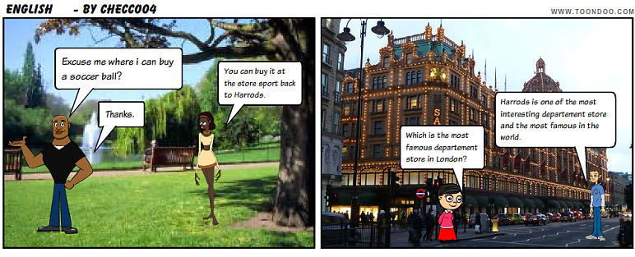

Slide 28
UNIT 9: YOU MUST STAY TOGETHER!

Slide 29
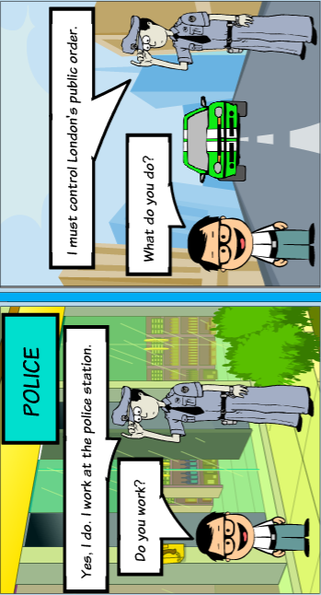
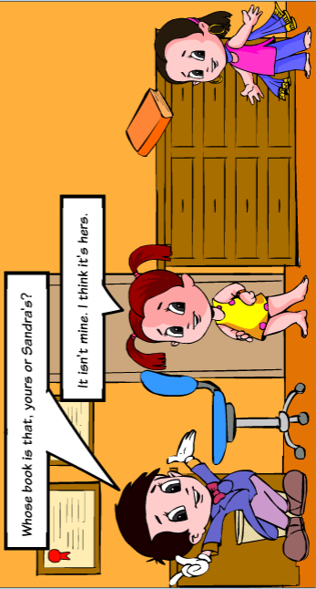

Slide 30
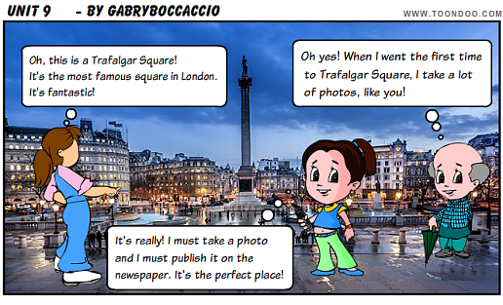

Slide 31
UNIT 10: I HAVE TO TIDY MY BEDROOM!

Slide 33
Dedicated to.....

Slide 35
By…. 2°D!!

