Slide 1
FROM LEXICON TO CREATIVITY

Slide 2
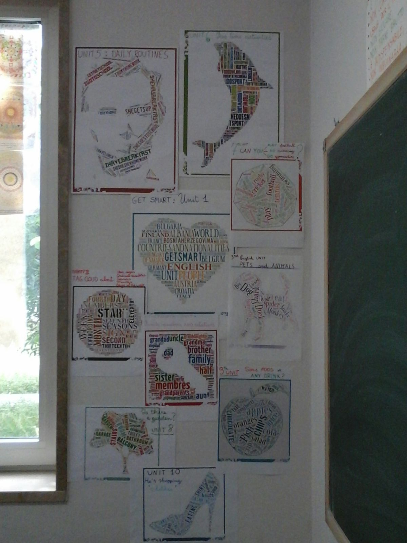
S
M
A
R
T
G
E
T

Slide 3
UNIT 1
PRONOMI E AGGETTIVI
I MY ME
YOU YOUR YOU
HE HIS HIM
SHE HER HER
IT ITS IT
WE OUR US
YOU YOUR YOU
THEY THEIR THEM

Slide 4
UNIT 2
TO BE
I am I’m
you are you’re
he she it is he’s she’s it’s
we are we’re
you are you’re
they are they’re

Slide 5
UNIT 3
TO HAVE GOT
I have got I’ve got
You have got you’ve got
He she it has got he’s she’s it’s got
We have got we’ve got
You have got you’ve got
They have got they’ve got

Slide 6
UNIT 4
GENITIVO SASSONE
‘s
ex : luca’s favourite
SUBJECT IS ENGLISH.

Slide 7
UNIT 5
DAILY ROUTINES
I always go to school
I do my homework every day

Slide 8
UNIT 6
PRESENT SIMPLE
Forma negativa
I don’t play tennis
you don’t run
he she it doesn’t ski
we don’t ride a bike
you don’t watch tv
they don’t send emails

Slide 9
UNIT 7
CAN
I CAN PLAY FOOTBALL
SHE CAN’T GO FENCING
CAN YOU DO SPORT?

Slide 10
UNIT 8
THERE IS
THERE ISN’T
IS THERE..?
THERE ARE
THERE AREN’T
ARE THERE..?

Slide 11
UNIT 9
SOME AND ANY
Some:
frasi affermative
ex: I would like some bread
Any:
frasi interrogative
e negative
ex: I wouldn’t like any drink

Slide 12
UNIT 10
PRESENT CONTINUOUS
I AM WEARING
YOU ARE BUYING
HE/SHE/IT IS TRYING
WE ARE SHOPPING
YOU ARE WALKING
THEY ARE LOOKING

Slide 13
KEEP LEARNING ENGLISH AND ENJOY SCHOOL! by 1st D COTUGNO

